Slide 1

ML in Energy Commodities
Models: Elastic Net, VAR, XGBoost, LSTM
Name: Dhairya Dhamani
Notes:
Today I’ll be presenting my project on applying machine learning models to forecast oil returns using macroeconomic variables.
I compare four different modeling approaches: a linear benchmark with Elastic Net, a multivariate econometric model using VAR, a nonlinear tree-based model with XGBoost, and a deep sequence model using LSTM.
Before getting into the models, one important modeling decision is the target variable.
Instead of forecasting oil prices directly, I forecast log returns.
We could have modeled price levels, and in fact that often produces higher R² mechanically because prices are highly persistent. But doing so would violate key econometric assumptions.
Oil prices are non-stationary and behave close to a unit root process. Modeling levels in that setting can produce spurious regression results and misleading inference.
Log returns, on the other hand, are approximately stationary. They allow us to:
Maintain consistent statistical assumptions
Interpret coefficients in percentage terms
Evaluate true predictive power rather than persistence
So throughout this presentation, the focus is on forecasting returns - which is the more economically meaningful and statistically sound framework.

Slide 2
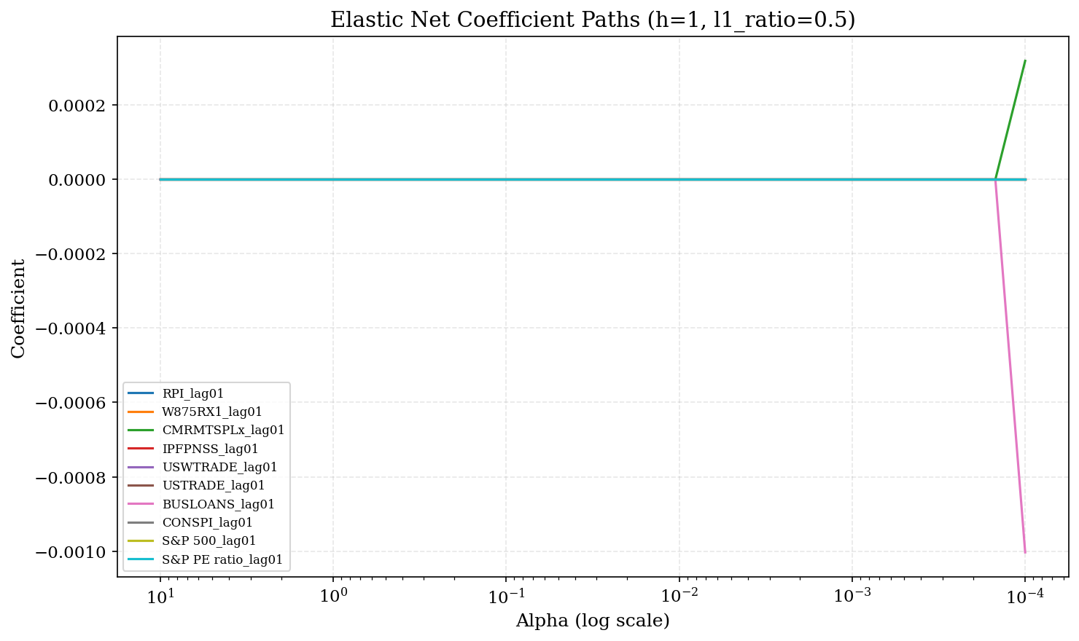
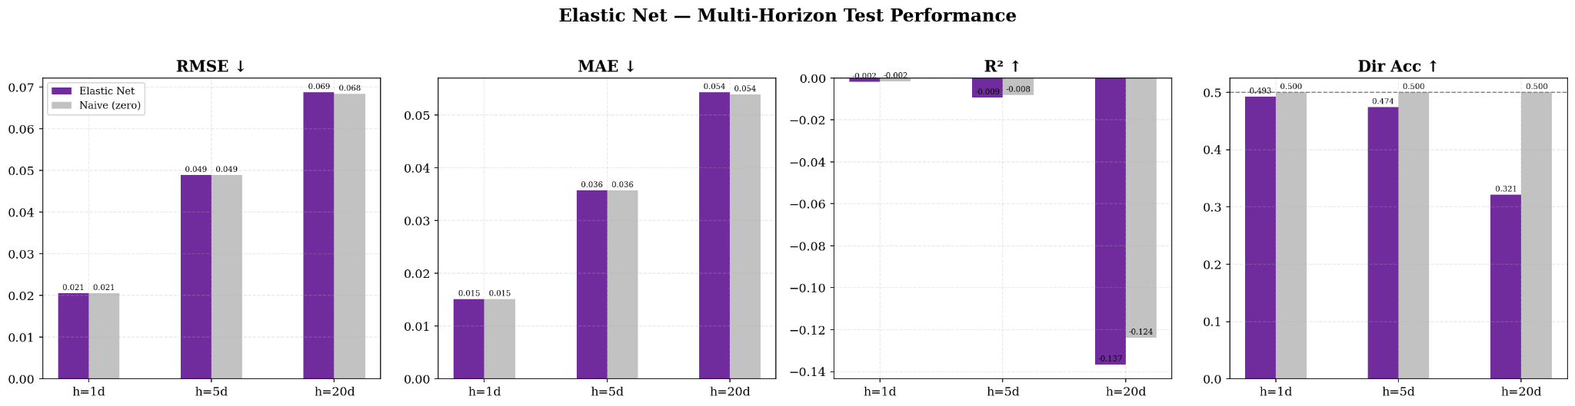
Elastic Net
Regularized Linear Regression (L1 + L2 Penalty)
Goal: Predict WTI log return
Best Hyperparameters
h
𝛂
l1
1D
0.01
0.5
5D
0.0215
0.2
20D
0.0215
0.8
Notes:
Elastic Net is my starting point - it’s the clean, disciplined linear benchmark.
At its core, it’s just linear regression with regularization. Because we’re working with over 900 lagged macro features, many of which are highly correlated, regularization isn’t optional - it’s necessary. Elastic Net balances L1 and L2 penalties so it can shrink unstable predictors while still handling correlated groups of variables in a stable way.
Now the key question: does macro data actually help forecast short-term oil returns?
Here are the results:
For the 1-day horizon, performance is basically flat. RMSE is around 0.02, R² is essentially zero, and directional accuracy is just slightly above 50% - barely better than a coin flip.
At 5 days, the model doesn’t improve much. Errors increase, and R² remains near zero. Directional accuracy hovers around the high 40s.
At the 20-day horizon, performance actually worsens. R² turns clearly negative, and directional accuracy drops into the low 30s - worse than random.
So what does that tell us?
It suggests that, at least in a linear framework, lagged macroeconomic variables contain very limited predictive power for short-horizon WTI returns. The model ends up heavily shrinking coefficients, meaning it struggles to find stable signal.
That’s not necessarily a failure - it’s an important way to calibrate expectations. This gives us a realistic baseline. If more complex models outperform this meaningfully, then we know they are capturing nonlinear or temporal structure that a linear model cannot.
Elastic Net sets the floor.

Slide 3
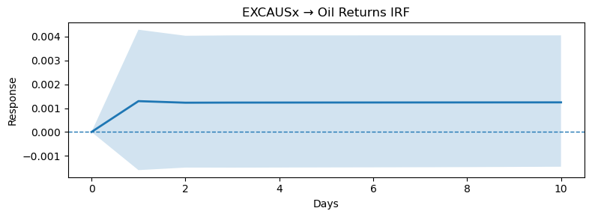
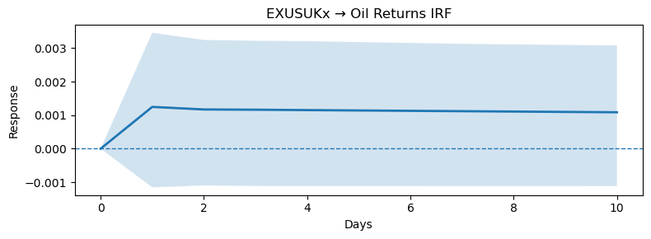
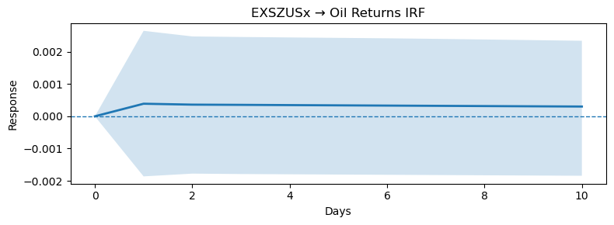
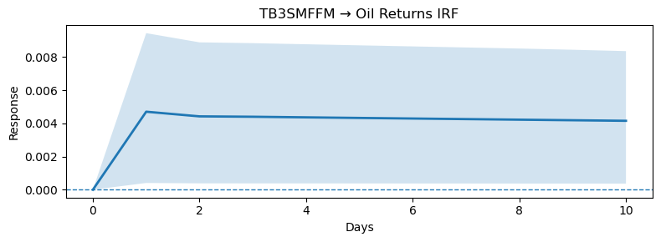
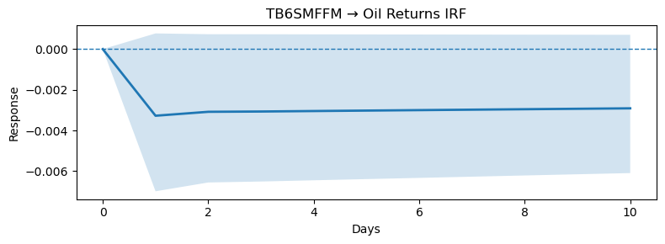
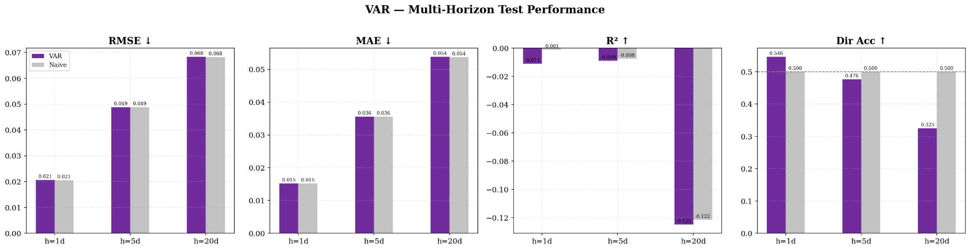
Vector Autoregression
Impulse Response Functions (IRFs, 1D)
Multivariate Econometric Sys. with Feedback Effects
Selected Features (Best Lag = 1)
EXCAUSx: Canada–U.S. FX Rate
EXUSUKx: U.S.–UK FX Rate
EXSZUSx: Switzerland–U.S. FX Rate
TB3SMFFM: 3M Treasury Spread vs Fed Funds
TB6SMFFM: 6M Treasury Spread vs Fed Funds
Notes:
VAR is different from the other models because it treats the system as fully interconnected.
Instead of assuming macro variables simply predict oil returns, VAR allows oil returns and macro variables to move together dynamically. So a shock to rates or FX today can affect oil tomorrow - and oil movements can feed back into the system as well.
Because a full 30-variable VAR would explode in size, I used BIC-based feature selection to keep the system focused. The final model selected five variables: three FX rates and two short-term Treasury spreads. That’s interesting in itself - it suggests that at daily horizons, financial variables matter more than real activity measures.
The best lag selected was just one day, which is consistent with how quickly information gets absorbed in financial markets.
Now looking at performance:
At the 1-day horizon, VAR slightly improves directional accuracy - about 54–55%, compared to 50% for naive. RMSE and MAE are essentially identical to the benchmark, and R² is slightly negative, which is expected for daily returns.
At 5 days, performance flattens out. Directional accuracy drops to the mid-40s, roughly in line with naive.
At 20 days, the model struggles. R² becomes clearly negative, and directional accuracy falls into the low 30s. That tells us that the dynamic structure doesn’t persist very far forward.
The impulse response functions give additional insight. For example, a positive shock to the 6-month Treasury spread generates a small, immediate negative response in oil returns that decays quickly. The effect is short-lived and statistically weak - which aligns with the low overall predictability we see in the forecast metrics.
So overall, VAR captures meaningful short-term financial linkages, but those effects are small and fade rapidly. It reinforces the broader conclusion that daily oil returns are very difficult to forecast using macro variables, even when we model feedback dynamics explicitly.

Slide 4
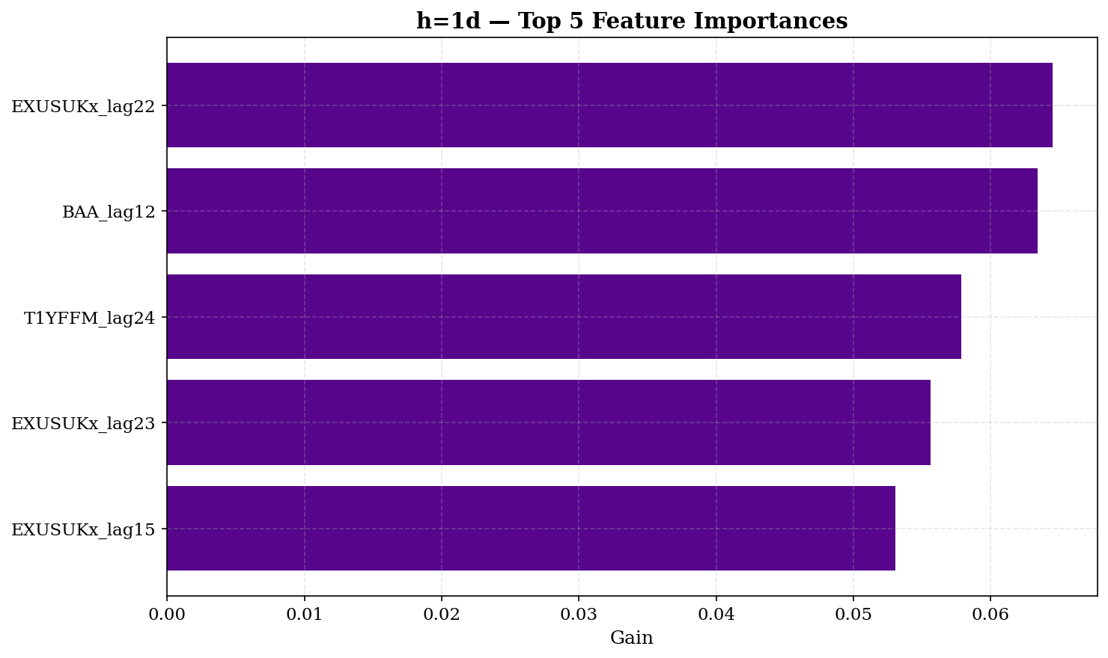
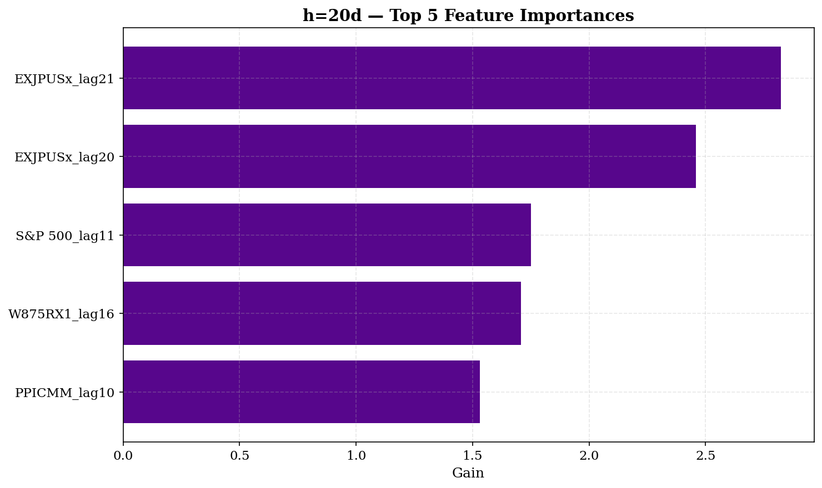
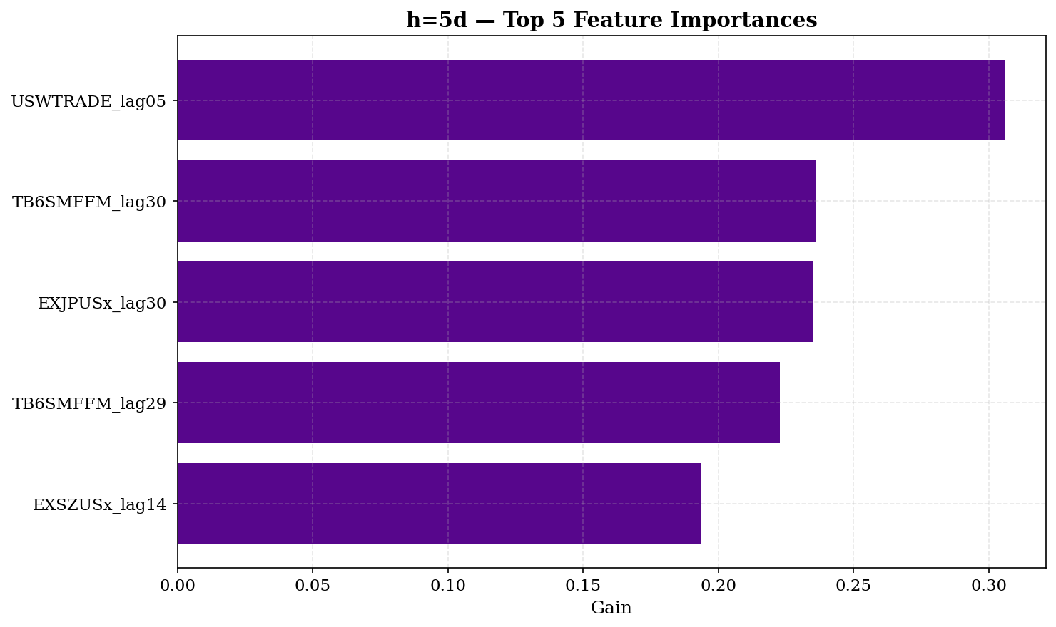
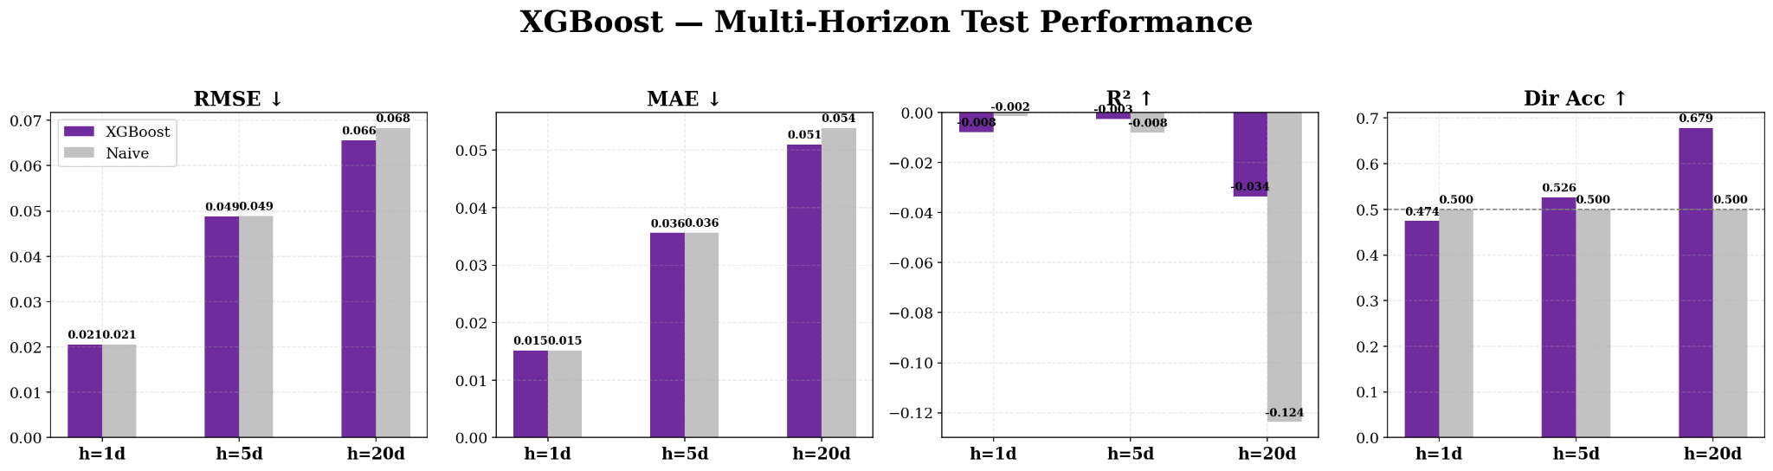
XGBoost
Extreme Gradient-Boosted Decision Trees
Best Hyperparameters
h
max_depth
LR
Subsample
Min child weight
1D
3
0.03
0.8
1
5D
3
0.03
0.8
1
20D
5
0.05
0.8
3
Notes:
XGBoost is our nonlinear benchmark.
Unlike Elastic Net, which assumes everything is linear, XGBoost can capture interactions and threshold effects. So instead of assuming each macro variable contributes additively, it can learn patterns like: FX movements only matter when rates are tight, or equity signals matter more in certain regimes.
Now looking at the results:
At the 1-day horizon, performance is very similar to the naive benchmark. RMSE and MAE are almost identical, and directional accuracy is slightly below 50%. So at very short horizons, nonlinear structure doesn’t seem to help much.
At the 5-day horizon, we start to see improvement in directional accuracy - about 52–53%, compared to 50% for naive. That suggests some weak nonlinear signal begins to emerge over a slightly longer window.
But the most interesting result is at the 20-day horizon.
Here, directional accuracy jumps to roughly 68%, which is a large improvement over naive. Even though R² is still negative - which is common in return forecasting - the directional signal is much stronger.
So the takeaway is that XGBoost appears to extract nonlinear patterns that are not visible in the linear models, particularly at longer horizons.
Looking at the feature importance plot, we see that FX variables - especially lagged Japanese exchange rates - dominate. That reinforces the idea that currency dynamics and global financial conditions are key drivers of oil returns at the monthly horizon.
So compared to Elastic Net and VAR, XGBoost doesn’t dramatically reduce forecast error magnitude, but it does uncover nonlinear directional structure - especially at 20 days.
That makes it economically interesting, even if traditional R² remains low.

Slide 5
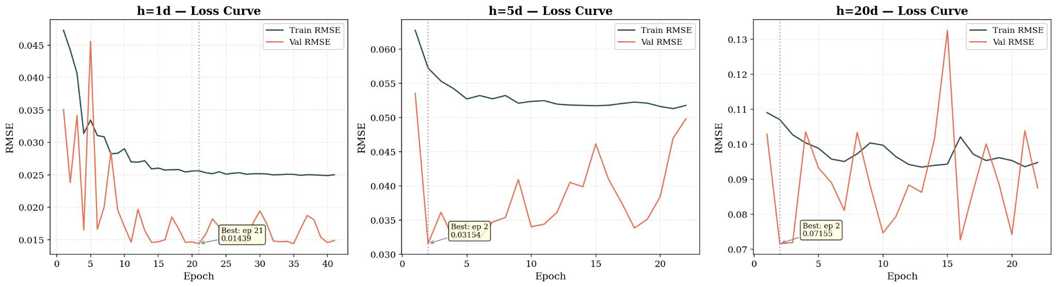
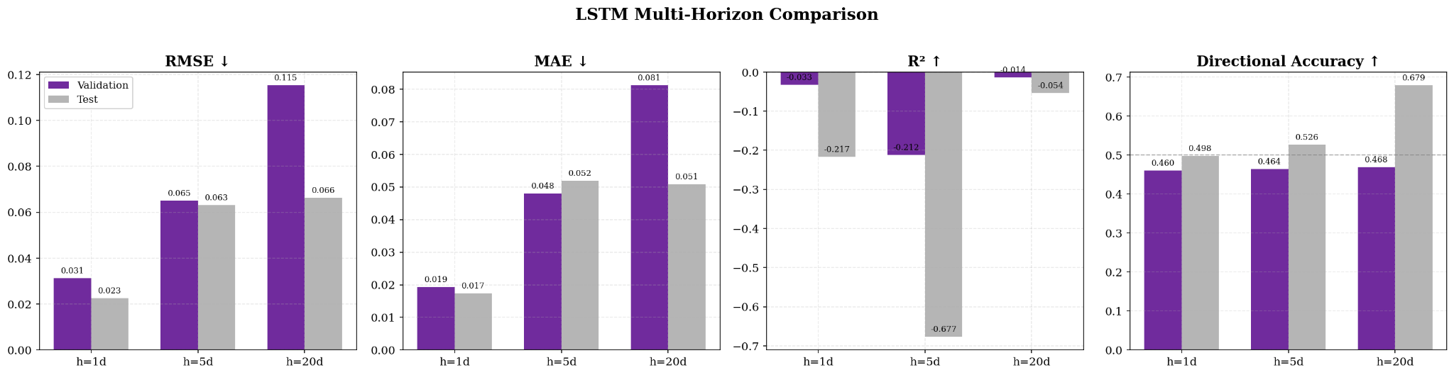
LSTM Network
Long Short-Term Memory - Deep Sequence Model
Best Hyperparameters
h
hs
nl
lr
1D
128
2
0.0005
5D
128
2
0.001
20D
64
2
0.001
Notes:
The LSTM is our deep learning model, built specifically for sequential data.
The key difference from the other models is that it doesn’t flatten the 30-day lookback into independent lag columns. Instead, it processes the data as an actual time sequence. That means it can learn patterns in how variables evolve over time, not just their values at fixed lags.
For example, it can distinguish between a steady rise in rates over 30 days versus a sharp spike and reversal - patterns that would look very similar once flattened.
Now looking at performance:
At the 1-day horizon, the LSTM doesn’t outperform the simpler models. Test RMSE is about 0.023, and directional accuracy is around 50% - essentially random. So deep sequence modeling does not help at very short horizons.
At 5 days, performance remains modest. RMSE increases as expected, and directional accuracy stays close to the mid-40s on validation and low-50s on test - nothing dramatically better than tree-based models.
But at the 20-day horizon, we see something interesting.
Test directional accuracy jumps to roughly 68%, which is quite strong. Even though R² is still negative - which is common in return forecasting - the directional signal becomes much more pronounced.
That suggests that sequential structure may matter more at longer horizons, where macro dynamics have time to propagate.
The loss curve on the top right also shows that the model converges quickly and early stopping prevents overfitting. Training error declines smoothly, while validation stabilizes around epoch 20.
So overall, the LSTM does not dominate at short horizons, but at 20 days it extracts meaningful directional structure that simpler models struggle to capture.
It suggests that temporal patterns - not just static lag relationships - may matter for medium-term oil return forecasting.

Slide 6
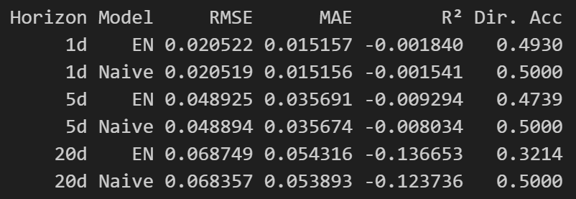
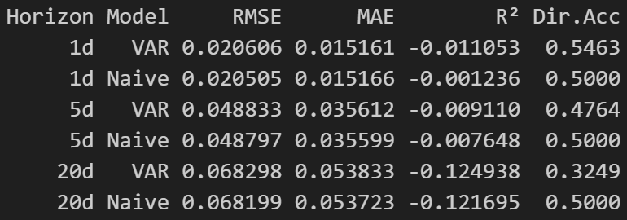
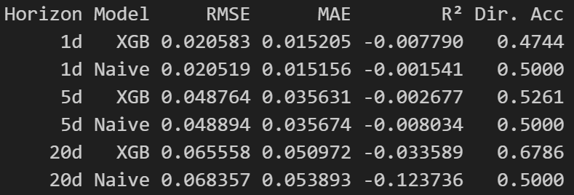
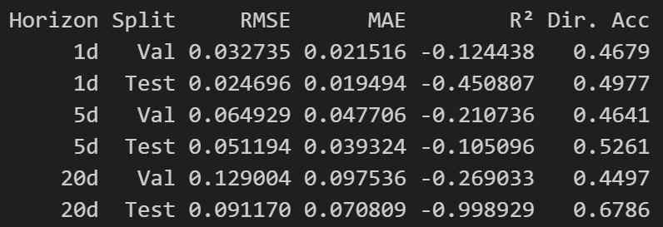
Summary
Elastic Net
VAR
XGBoost
LSTM
Overall, short-horizon oil returns are extremely difficult to forecast, with most models performing close to the naive benchmark. However, nonlinear models like XGBoost and LSTM show meaningful directional improvement at the 20-day horizon, suggesting weak but horizon-dependent nonlinear structure.
Notes:
This slide compares all four models across the three forecast horizons.
The first big takeaway is that short-horizon forecasting is extremely difficult.
At the 1-day horizon, every model performs almost identically to the naive benchmark. RMSE differences are tiny, R² is near zero or slightly negative, and directional accuracy stays around 50%. That tells us daily oil returns are largely noise.
At the 5-day horizon, we see slight variation across models, but still no dramatic improvement in error metrics. Directional accuracy begins to separate slightly, especially for XGBoost, but the gains remain modest.
The most interesting results occur at the 20-day horizon.
Here, two nonlinear models stand out:
XGBoost achieves directional accuracy of about 68%
LSTM also reaches about 68% on the test set
Meanwhile, Elastic Net and VAR remain near or below the naive benchmark.
Importantly, R² is still negative for most models, which is typical in return forecasting. But directional accuracy improves meaningfully at the longer horizon for nonlinear models.
So the pattern is clear:
Linear structure alone is weak
Dynamic linear systems help slightly but remain limited
Nonlinear models begin extracting signal at longer horizons
That suggests that if predictability exists, it is likely nonlinear and medium-term, rather than short-term and linear.
Overall, the differences in RMSE are small - which is typical for commodity return forecasting - but directional performance at 20 days indicates some economically meaningful structure may exist.
The key conclusion is not that oil is “predictable,” but that any predictive signal appears weak, nonlinear, and horizon-dependent.

